Slide 1

ASP.NET Workshop
By Howard University Microsoft Student Partners
Jeff Beauplan
Michelle Brown
Github: https://github.com/JayDougie/Test_webstite

Slide 2
Contents
Setting up the project
Understanding the structure of the project folder
Building/customizing the website
Deployment process via Azure Cloud Services

Slide 3
Things you need
Microsoft Visual Studio (With ASP.NET Package installed)
Azure Account (free passes provided)
Visual Studio Team Services Account (visualstudio.com)

Slide 4
Setting up the Project

Slide 5

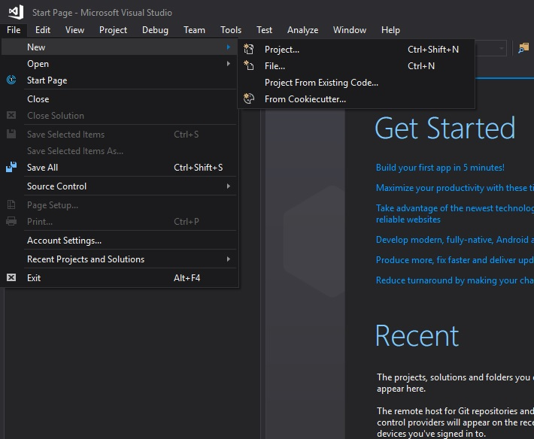
Open Visual Studio
Click New
Click Project

Slide 6
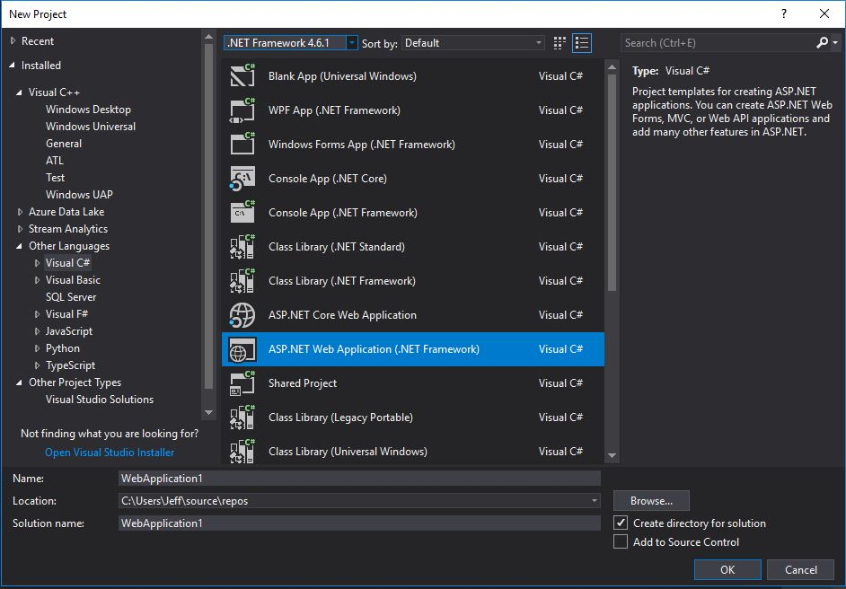
New Project Panel
On the side panel select Other Languages
Select Visual C#
Select ASP.NET Web Application
Click OK

Slide 7
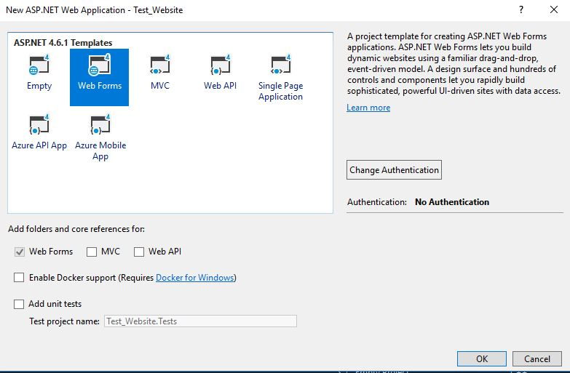
Select Web Forms
Click OK

Slide 8
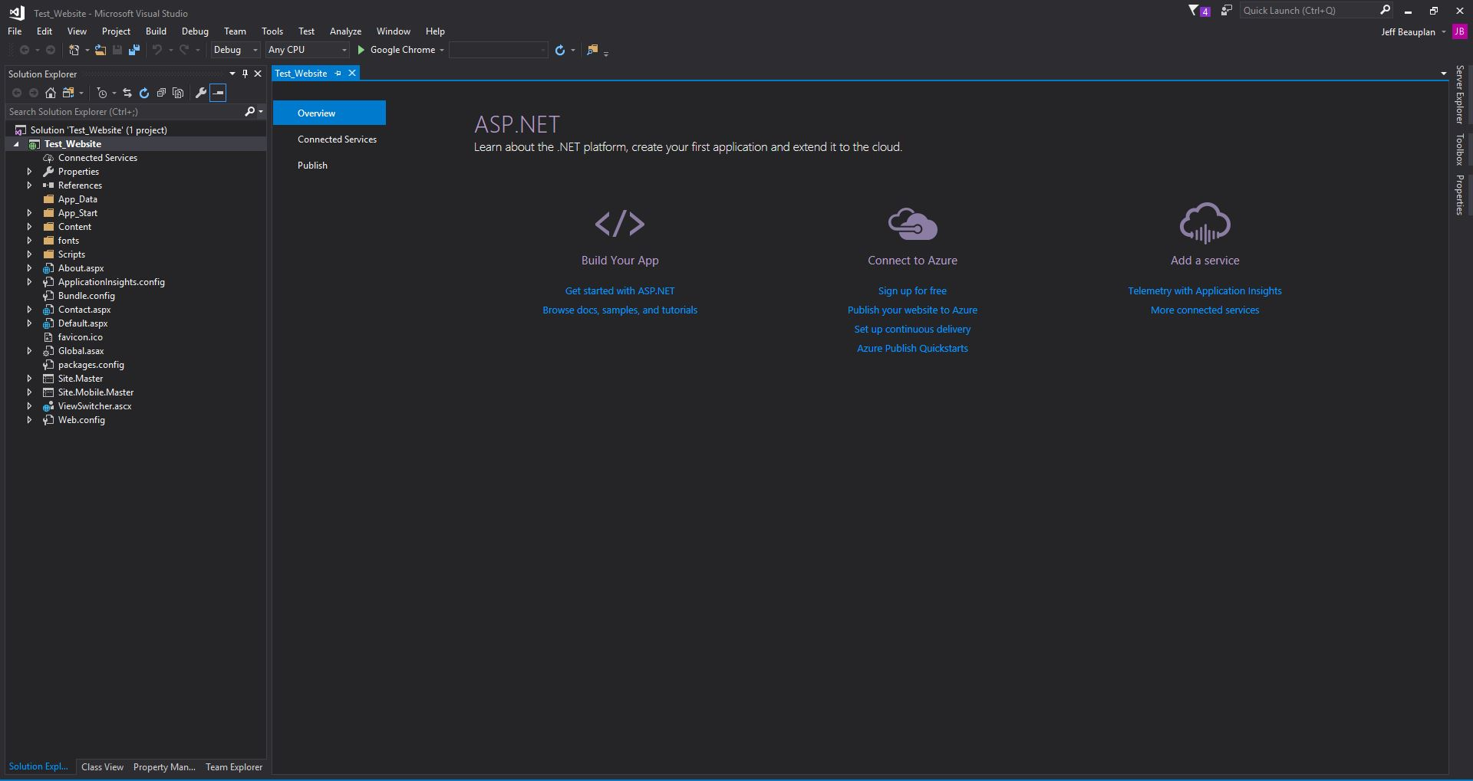

Slide 9
Understanding the Structure of the Project Folder

Slide 10
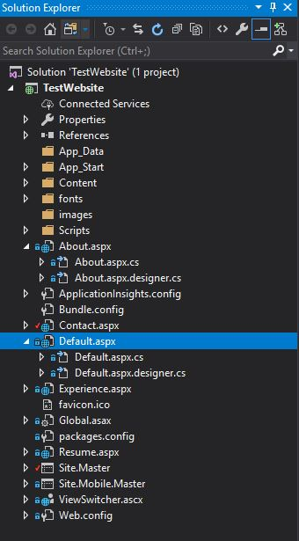
Each Page has a markup file and a code file
.aspx = Markup File
.aspx.cs = Code Files
.aspx.designer.cs = Joins Markup & Code
The master page is the default template that every page uses (your navigation menu and footer should be in the master page). Site.Master and Mobile.Master
Web.config holds specific settings about the behavior of your website.
The scripts folder contains any libraries that you import

Slide 11
Building/Customizing the website

Slide 12
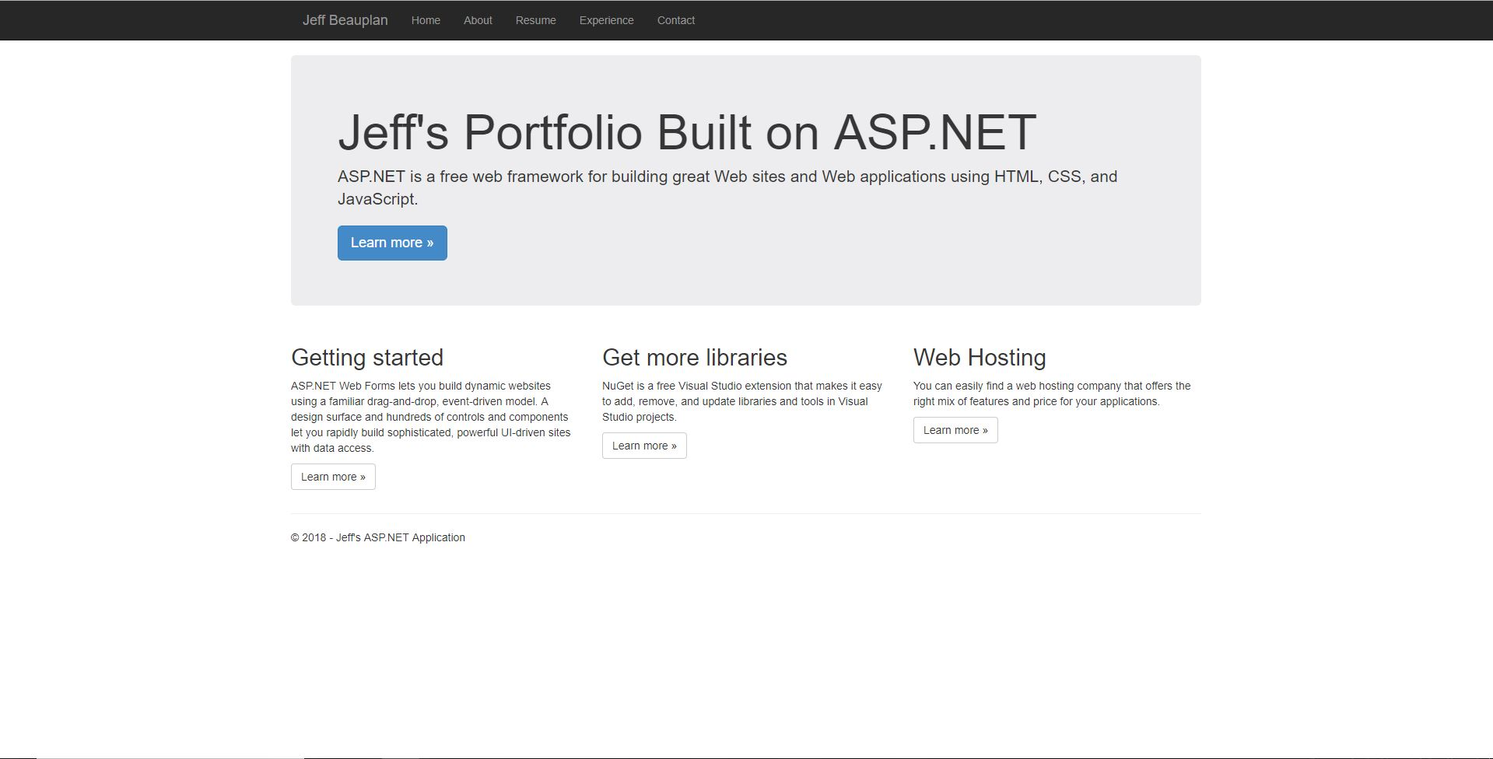
Home Page (default.aspx)

Slide 13
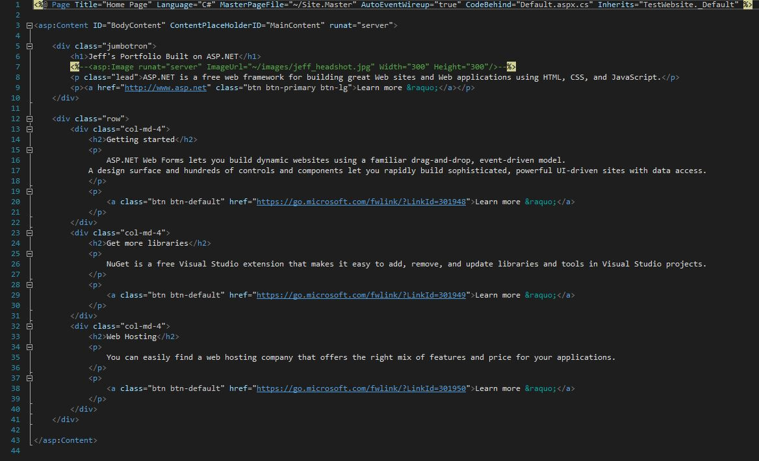

Slide 14
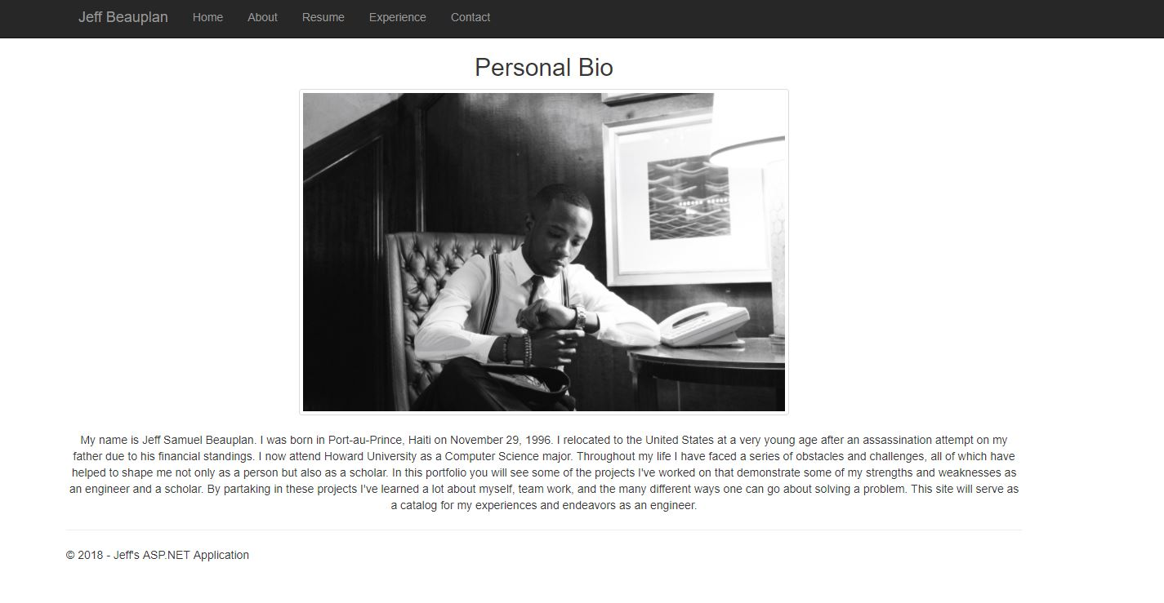
About Page (About.aspx)

Slide 15
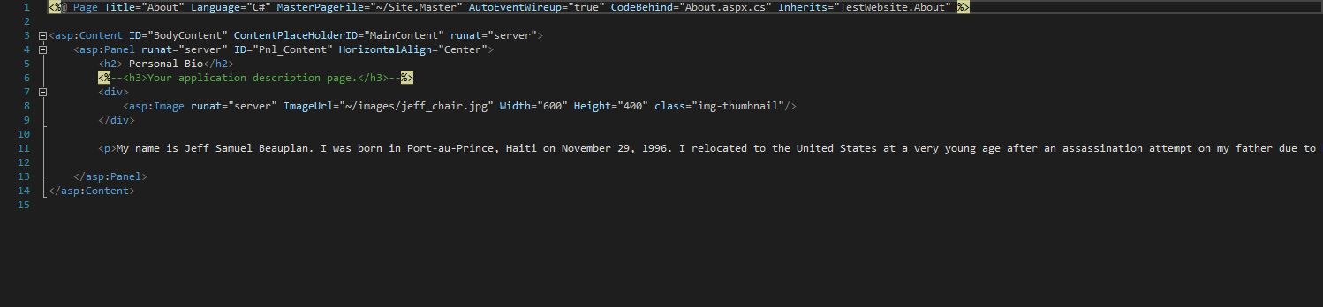

Slide 16
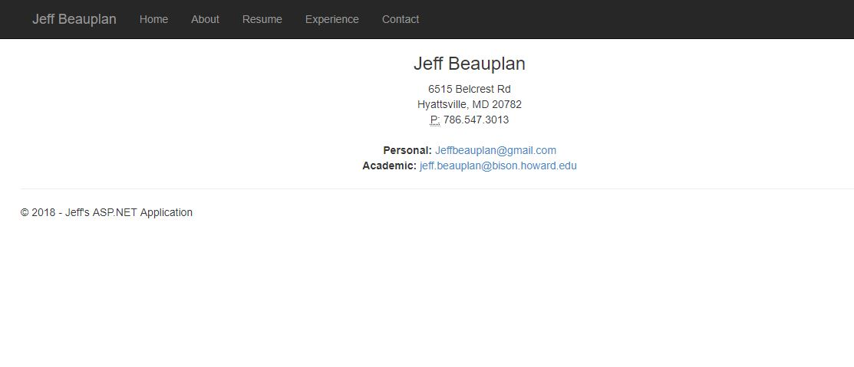
Contact Page (Contact.aspx)

Slide 17
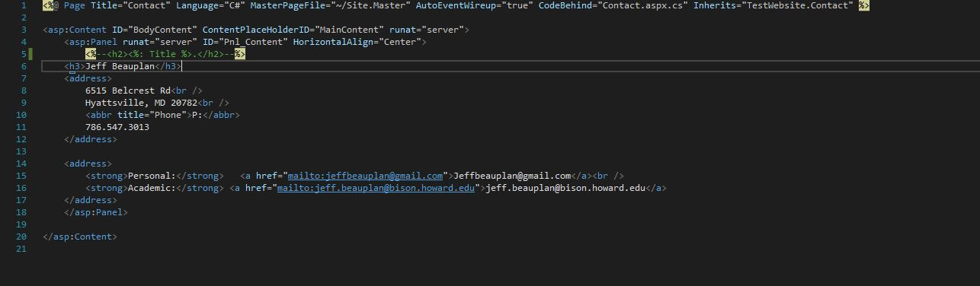

Slide 18
Deployment Process via Azure Cloud Services

Slide 19
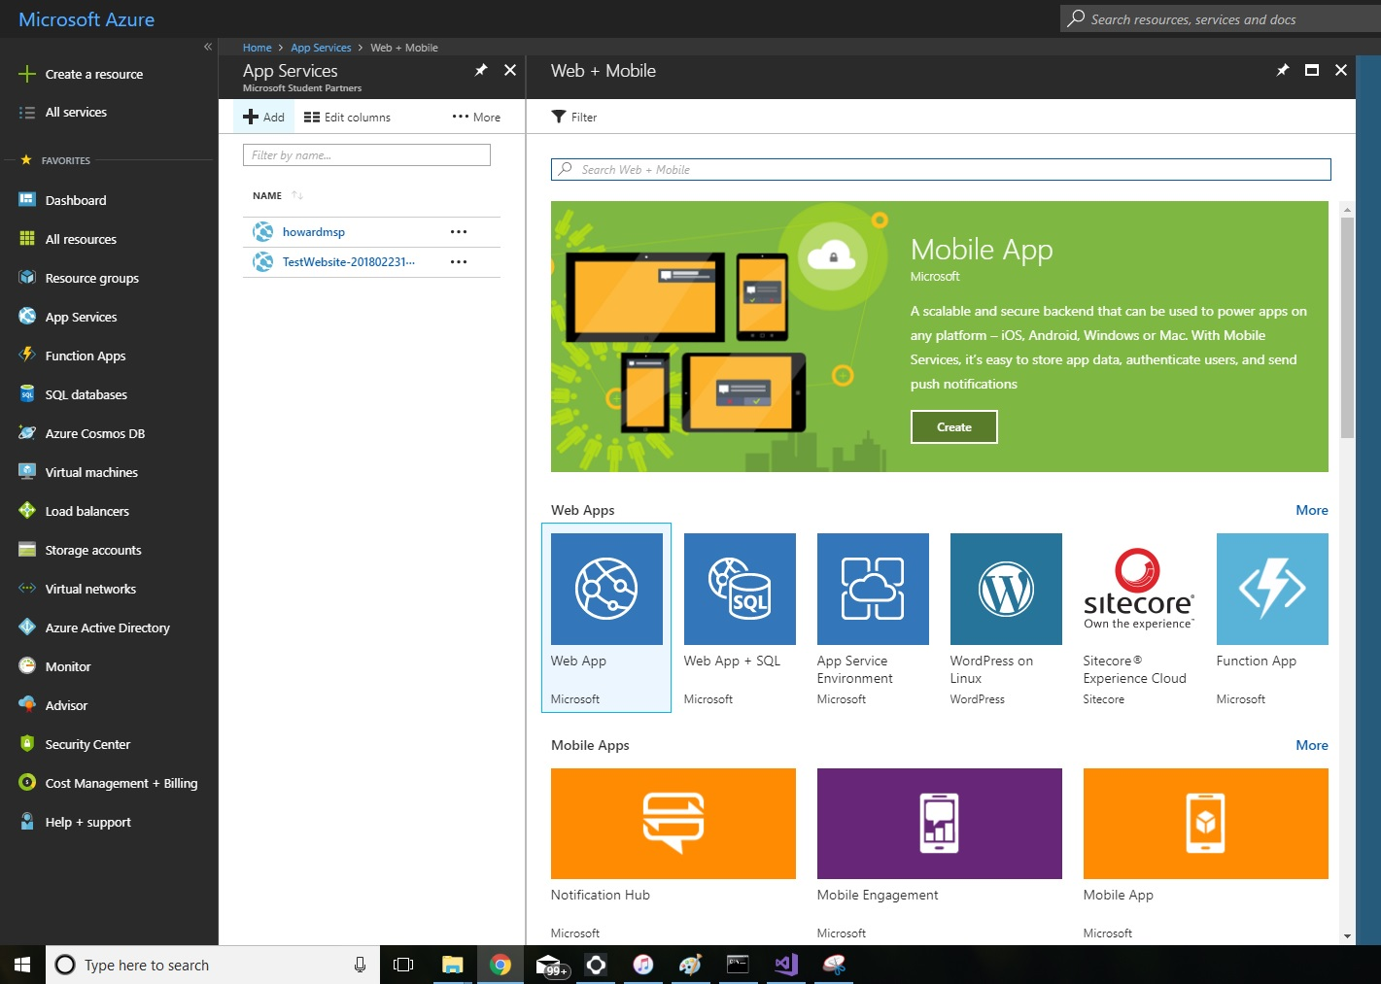
Go to portal.azure.com
Log in
Select App Services from side panel

Slide 20
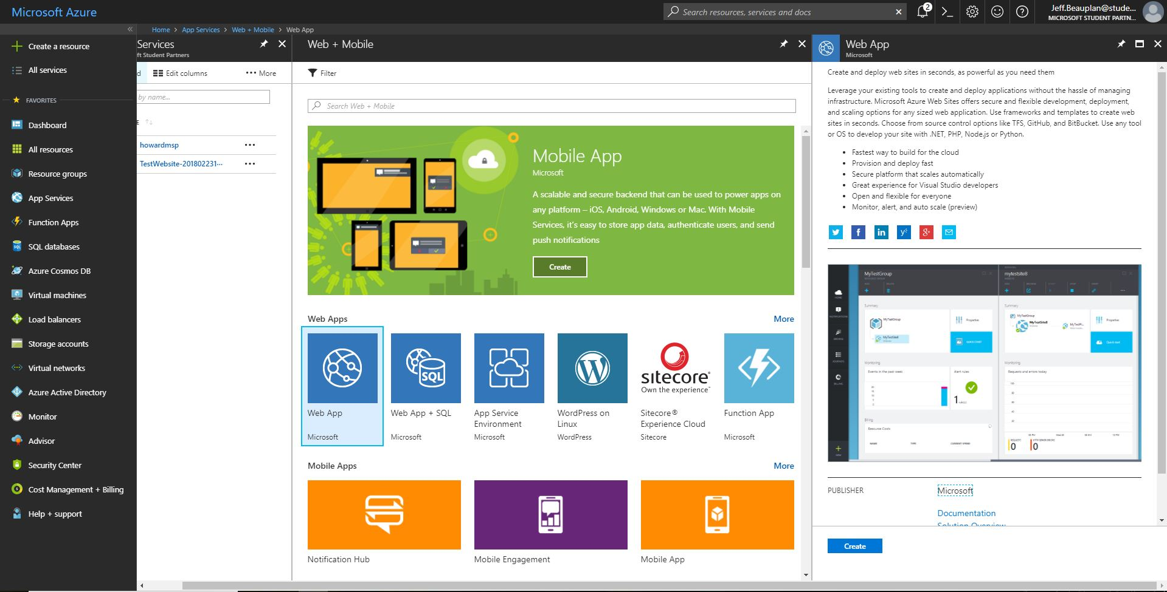
Select Web App and then click Create

Slide 21
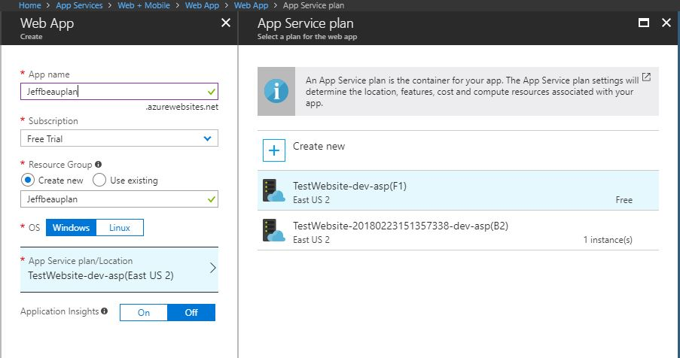
Enter your app name (this will eventually be the link that you use to go to your webstie)
Leave everything else on default. It automatically makes a new resource group for you with the app name

Slide 22
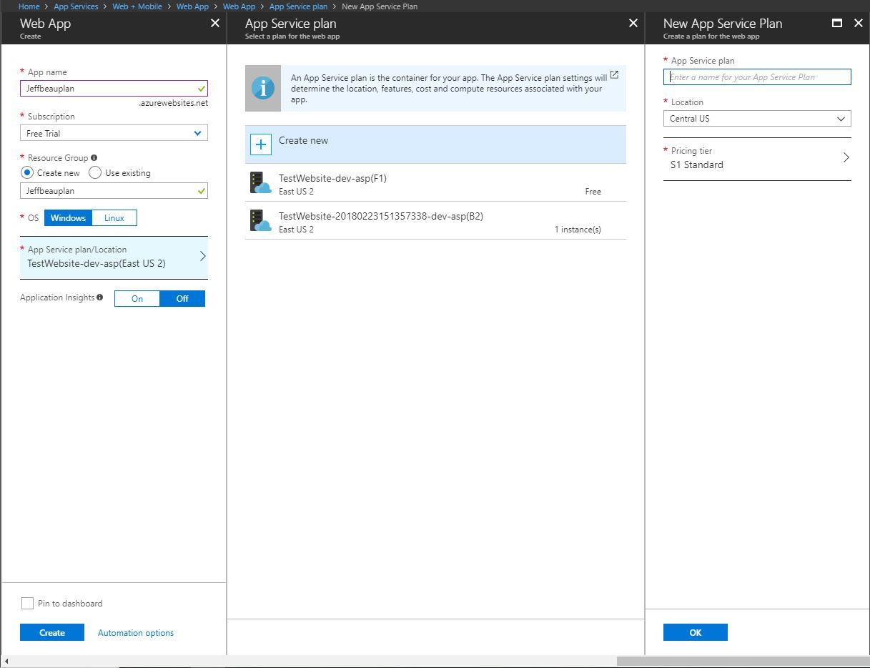
Click Create new under App Service Plan
Enter a name for the app service plan
Click Ok
Then Click Create

Slide 23
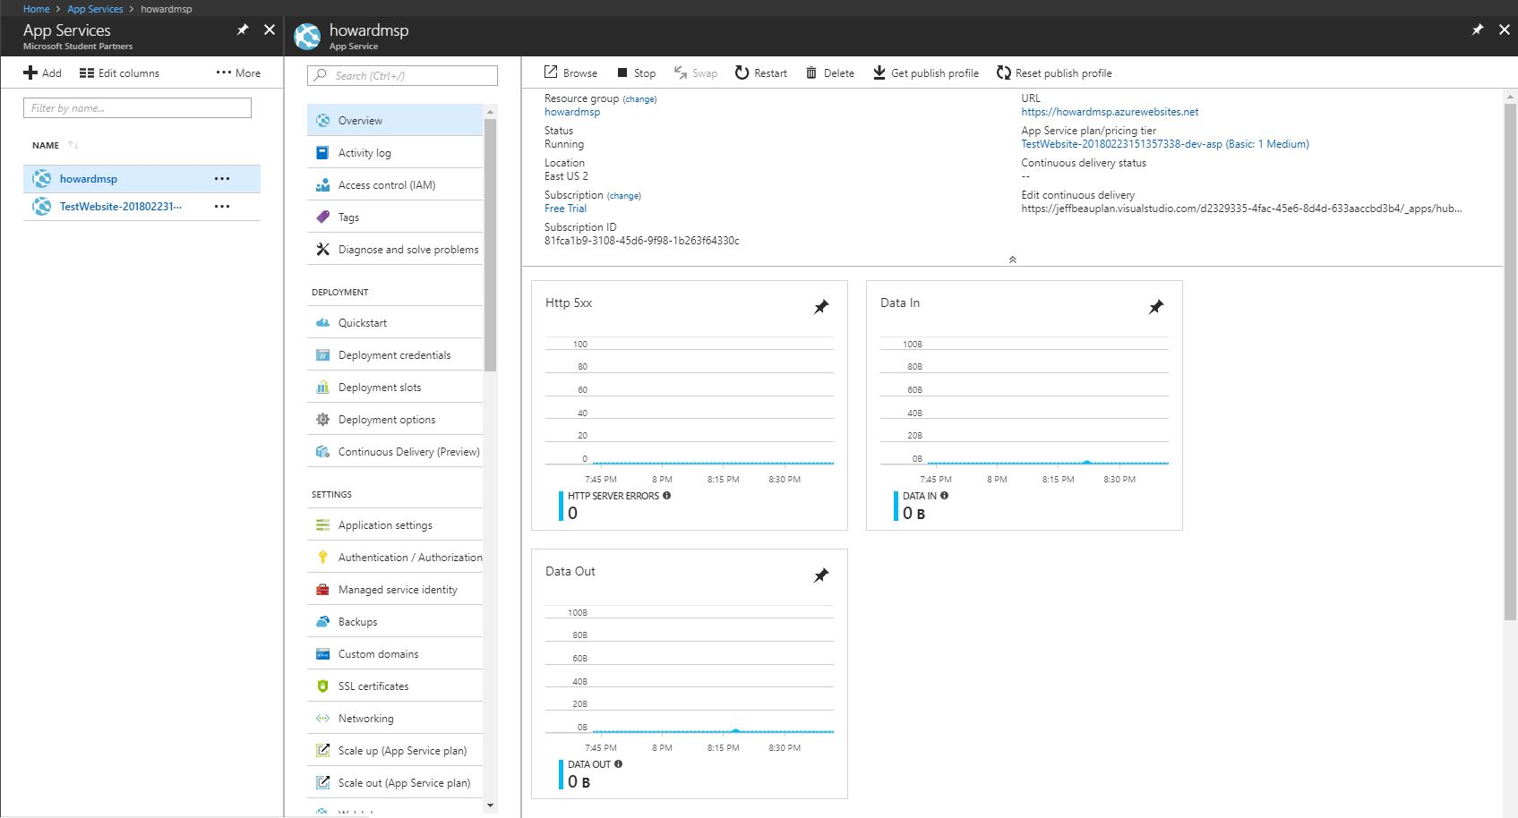
You should now be able to see your newly created app service under the App Services Menu

Slide 24
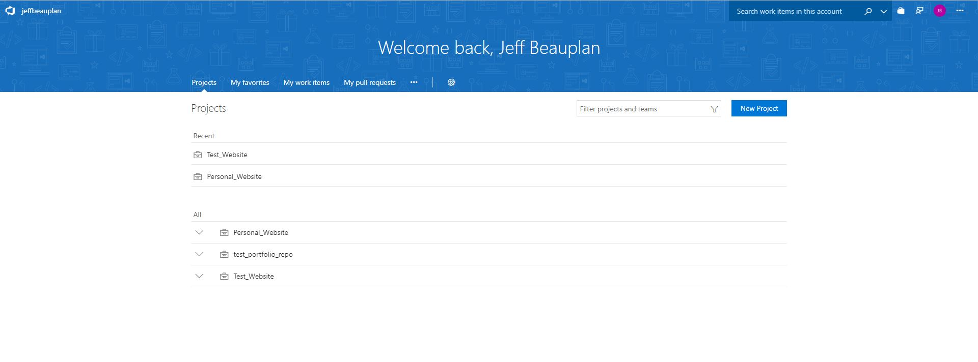
Log into your Visual Studio Team Services Account
Click New Project

Slide 25
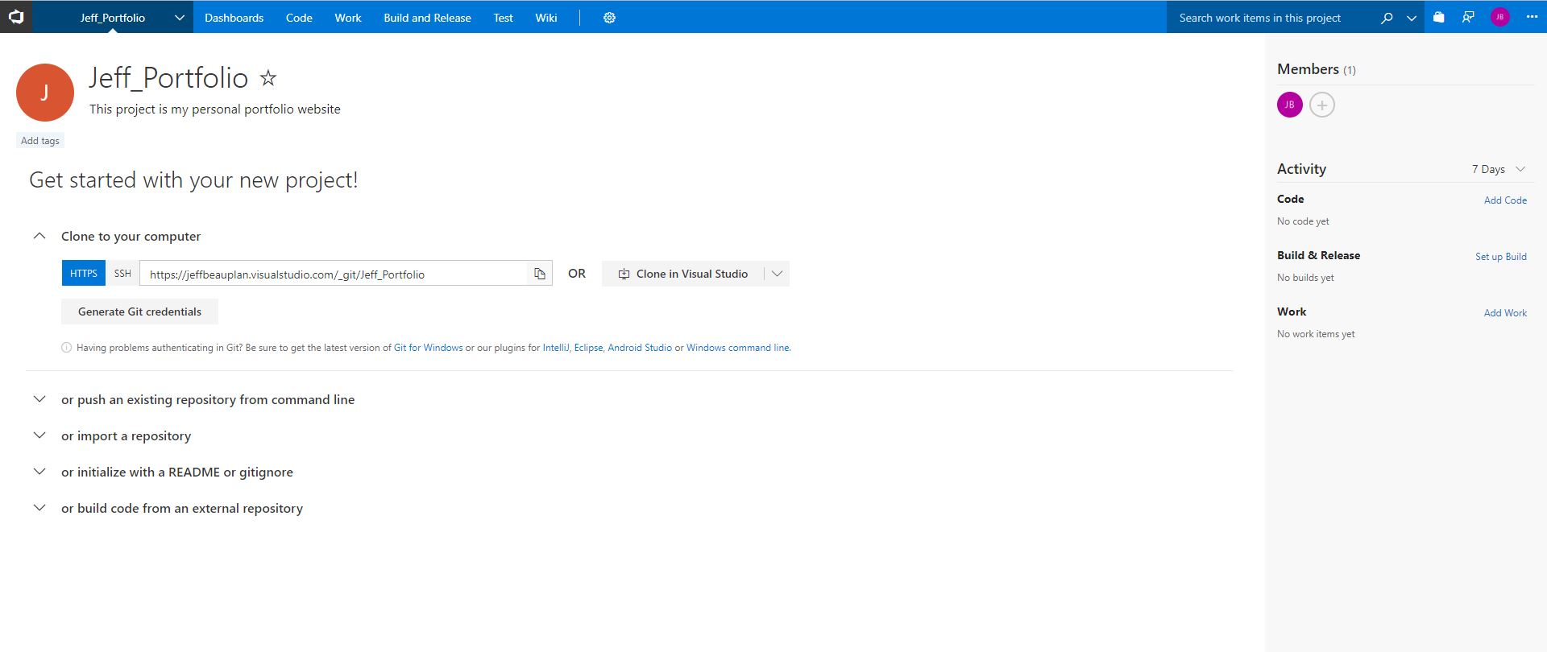
Once your Project is created its now time to clone the repository to your computer
Copy the HTTPS clone link

Slide 26
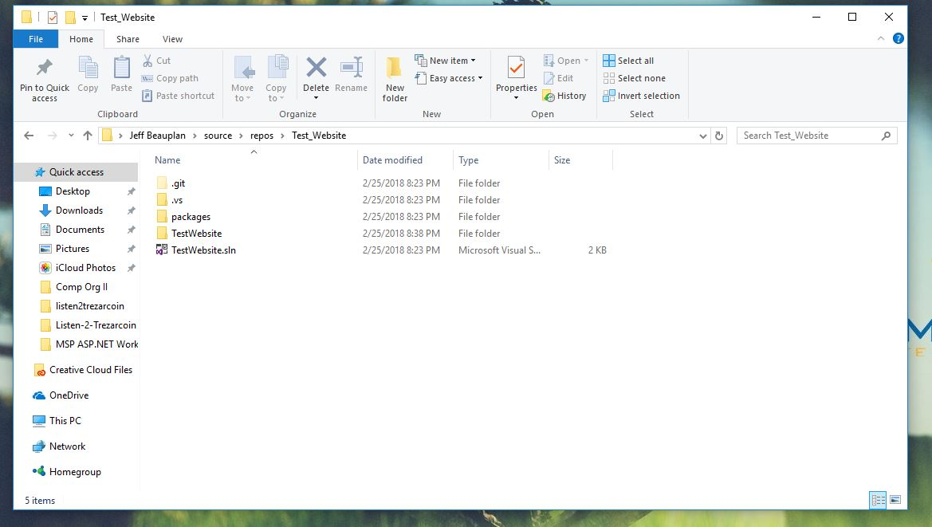
Navigate to your Visual Studio Project folder for the website

Slide 27
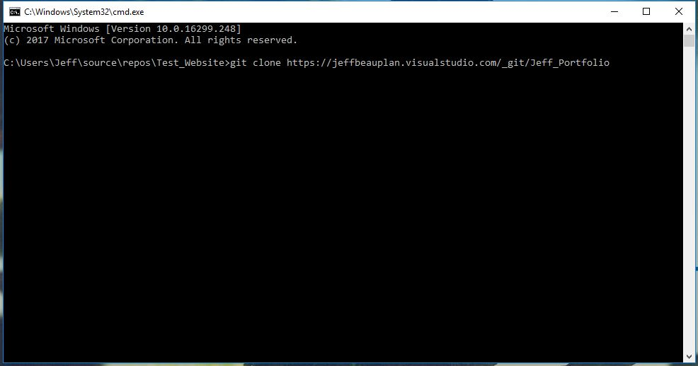
Open up a git terminal inside of the project folder
Type git clone [paste https clone link here]

Slide 28
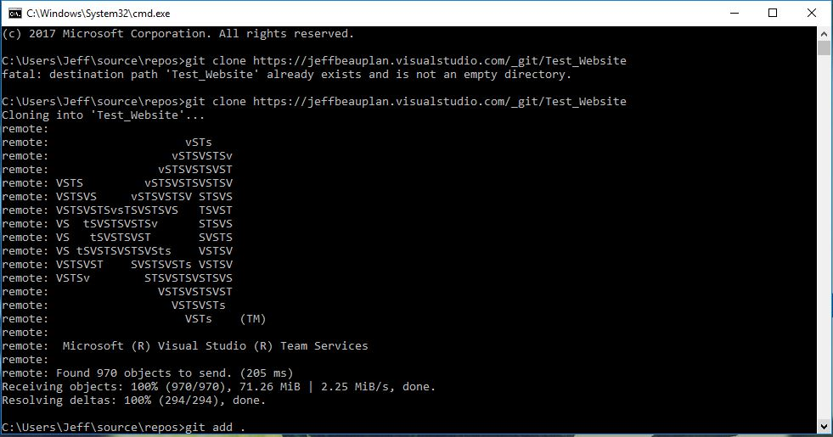
After cloning the repo its now time to sync your project files with the repo
Type git add .

Slide 29
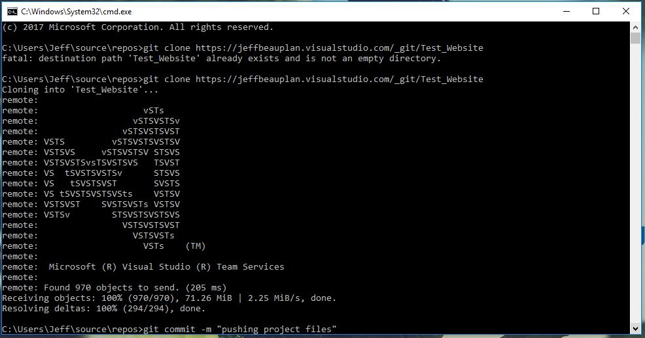
Type git commit –m “pushing project files”

Slide 30
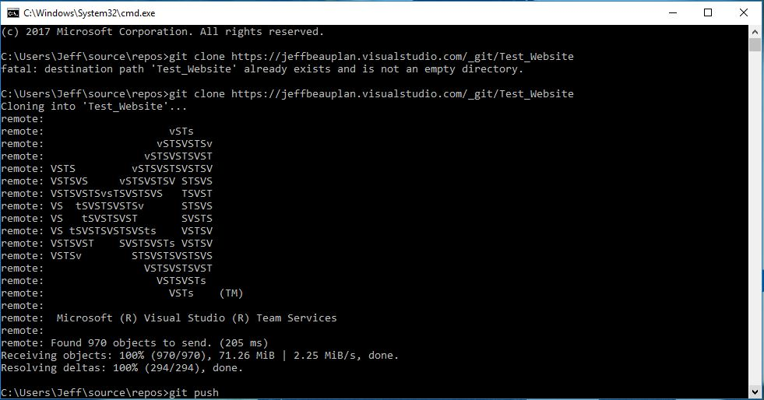
Type git push
Your visual studio Team Services repo should now be in sync with your visual studio project folder

Slide 31
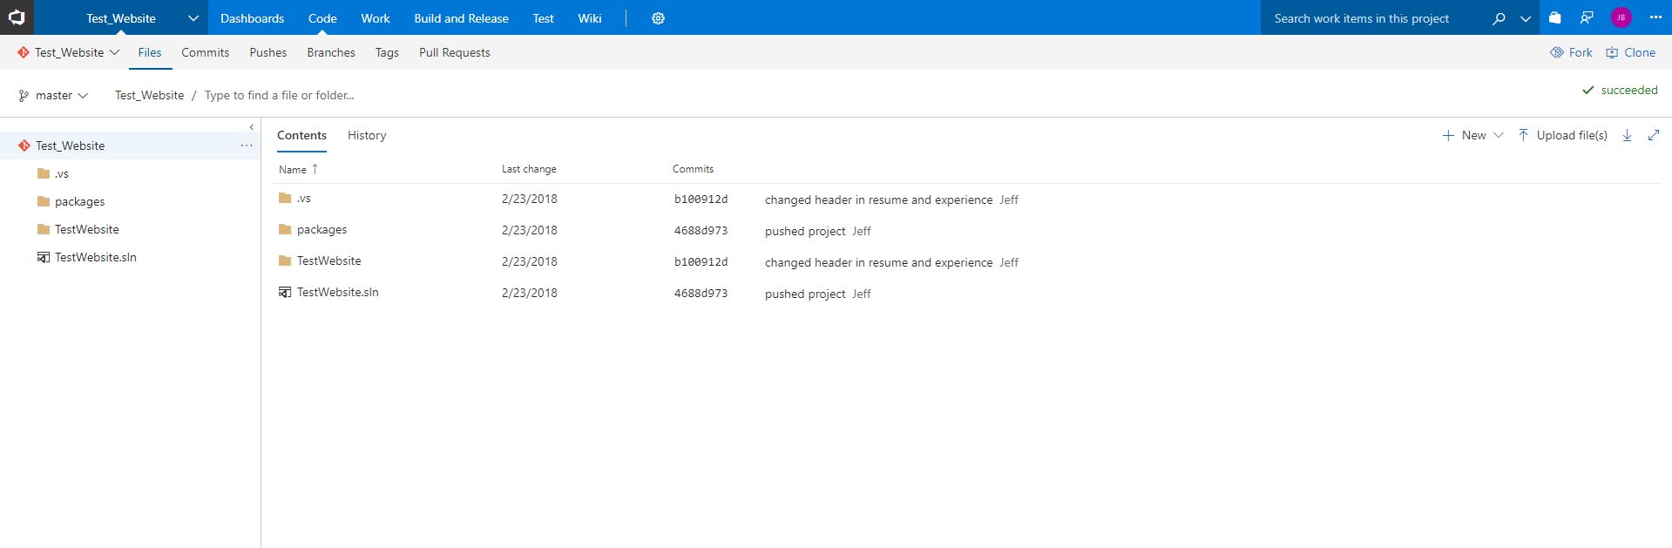
You should now be able to see your project files on the Visual Studio website

Slide 32
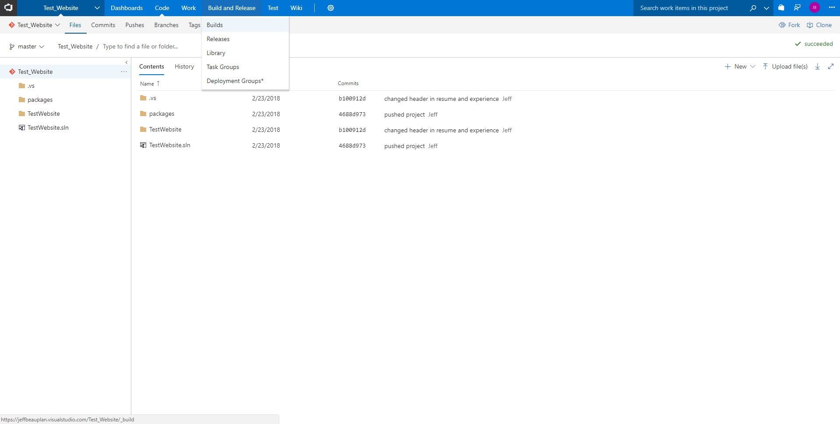
In the menu under Build and Release select Builds

Slide 33
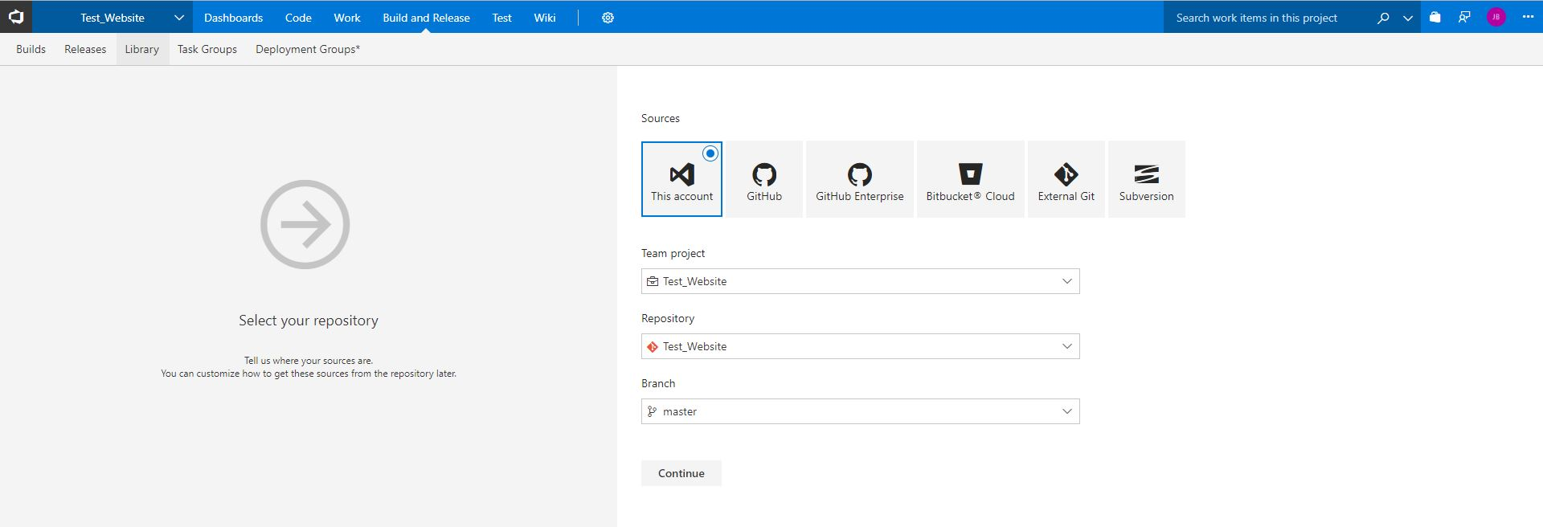
Make sure the correct project and repository is selected
Click Continue

Slide 34
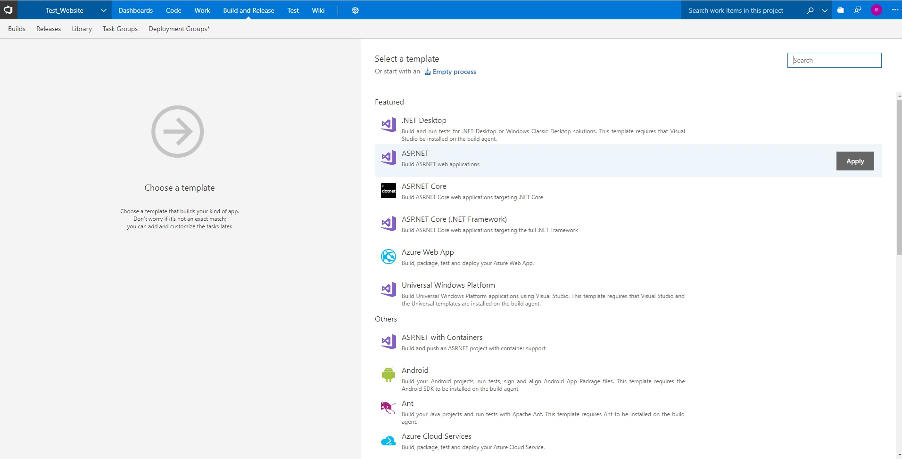
Select ASP.NET
Click Apply

Slide 35
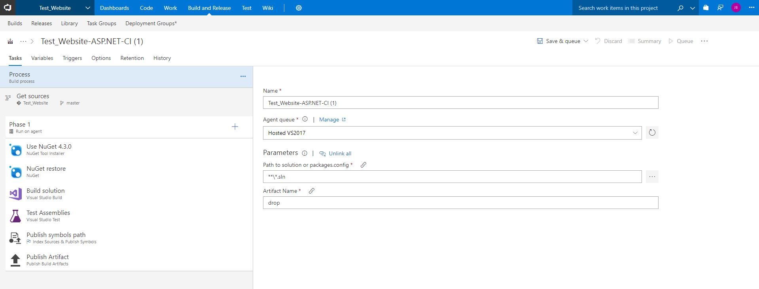
Click Triggers

Slide 36
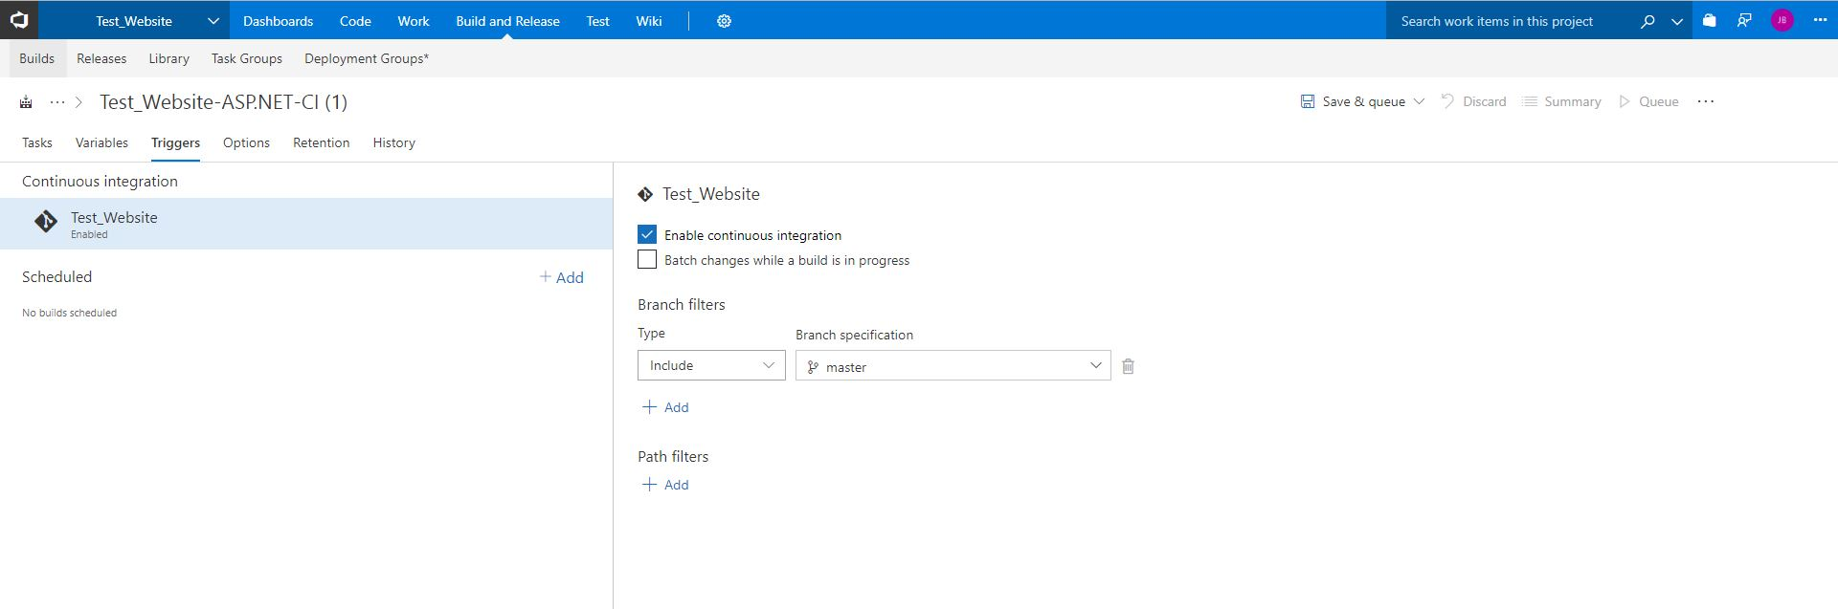
Select Enable continuous integration
Click Save & queue

Slide 37
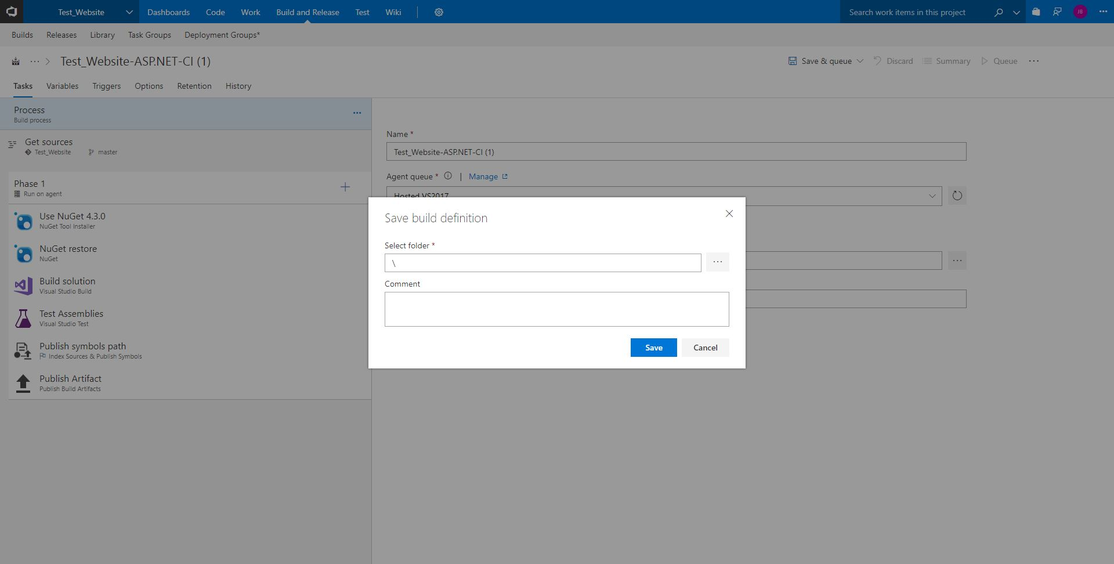
Click Save

Slide 38
Your first build should now be in progress

Slide 39
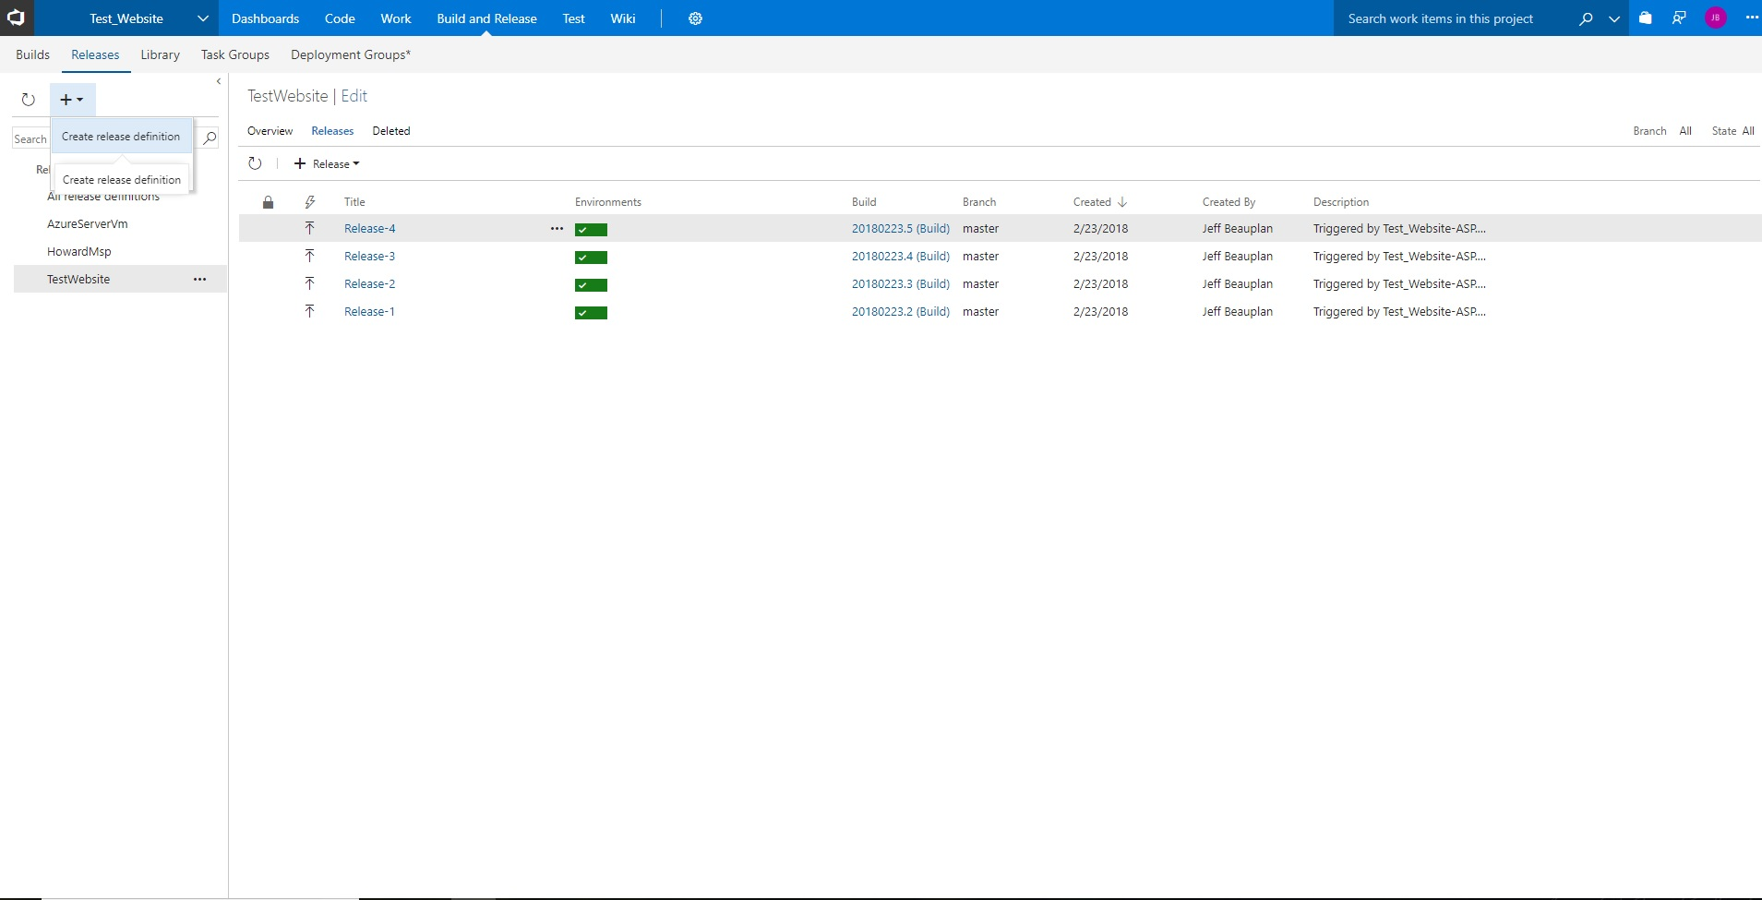
Click on Release from the Build and Release option from the top menu
Click the + icon and select Create release definition

Slide 40
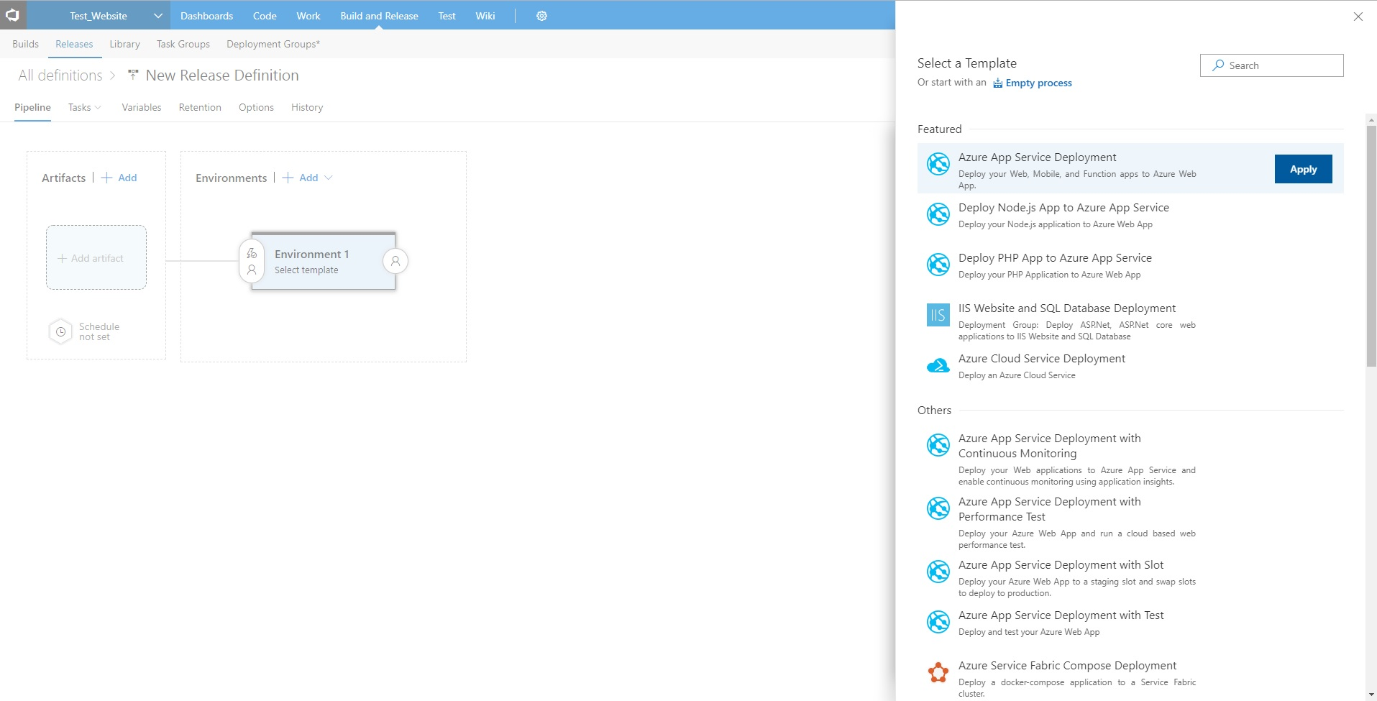
Select Azure App Service Deployment
* We’re going to deploy to the app service you created earlier in Azure

Slide 41
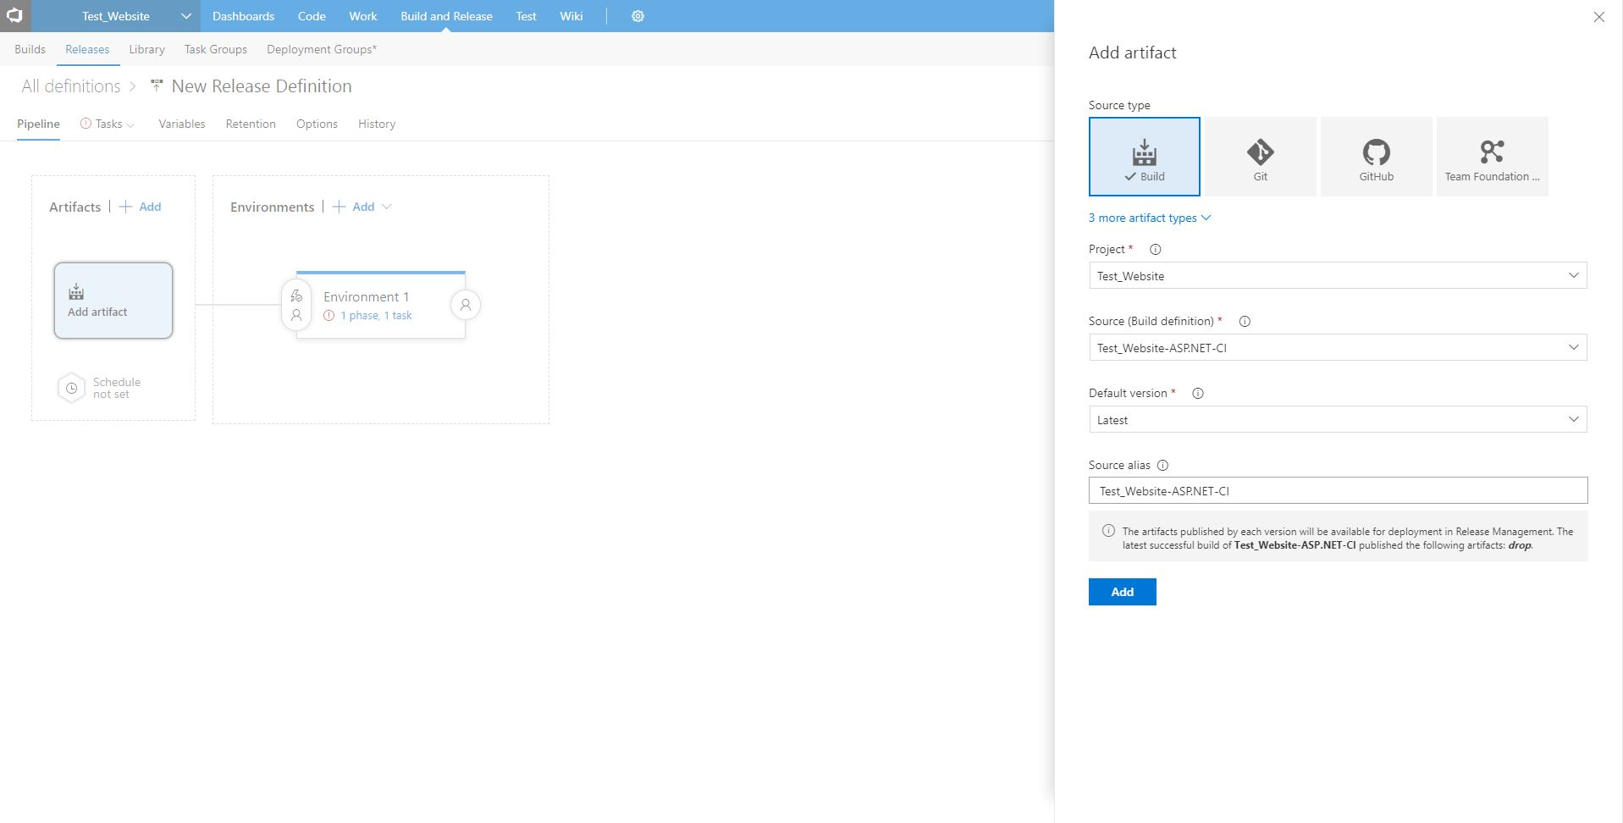
Click Add artifact
Select the build definition we created earlier
Click Add

Slide 42
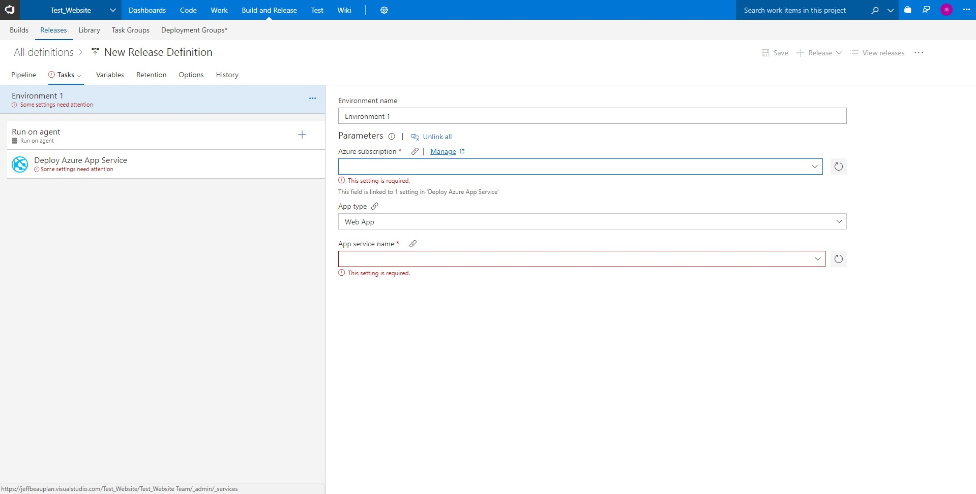
Click Task
Click Manage (next to the Azure Subscription option)

Slide 43
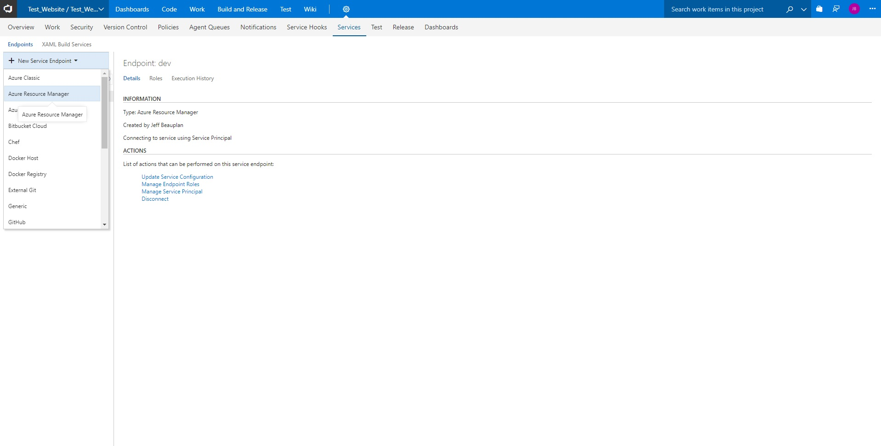
Click + New Service Endpoint
Select Azure Resource Manager

Slide 44
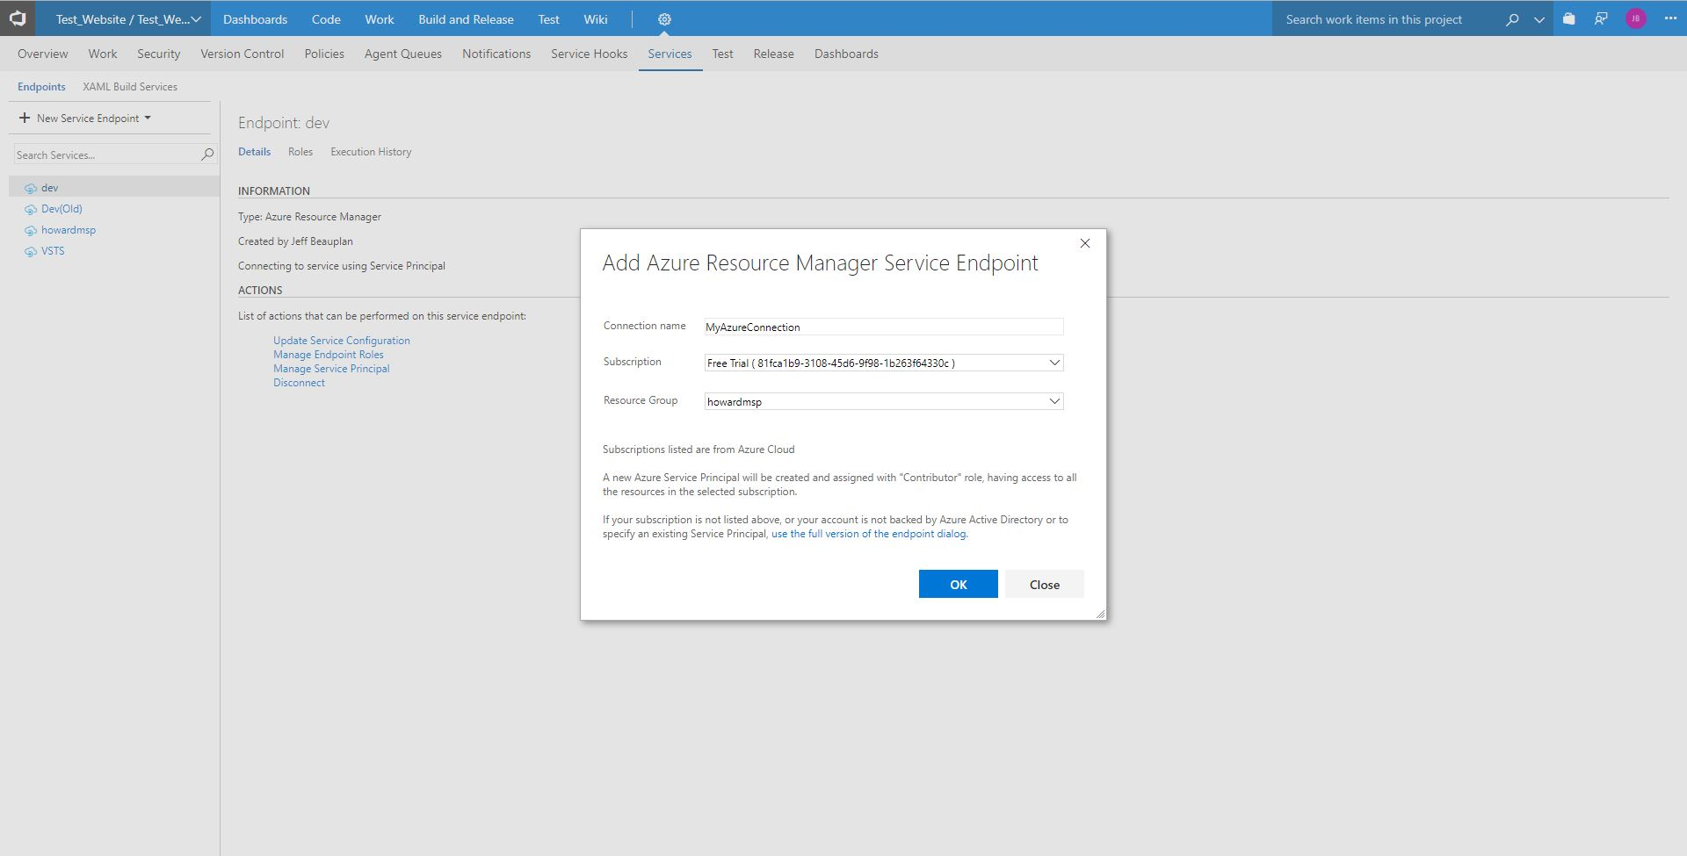
Type in a connection name (this establishes a connection between visual studio team services and your Azure account)
Select your subscription
Select the Resource group (should be the same name as your app service)
Click OK

Slide 45
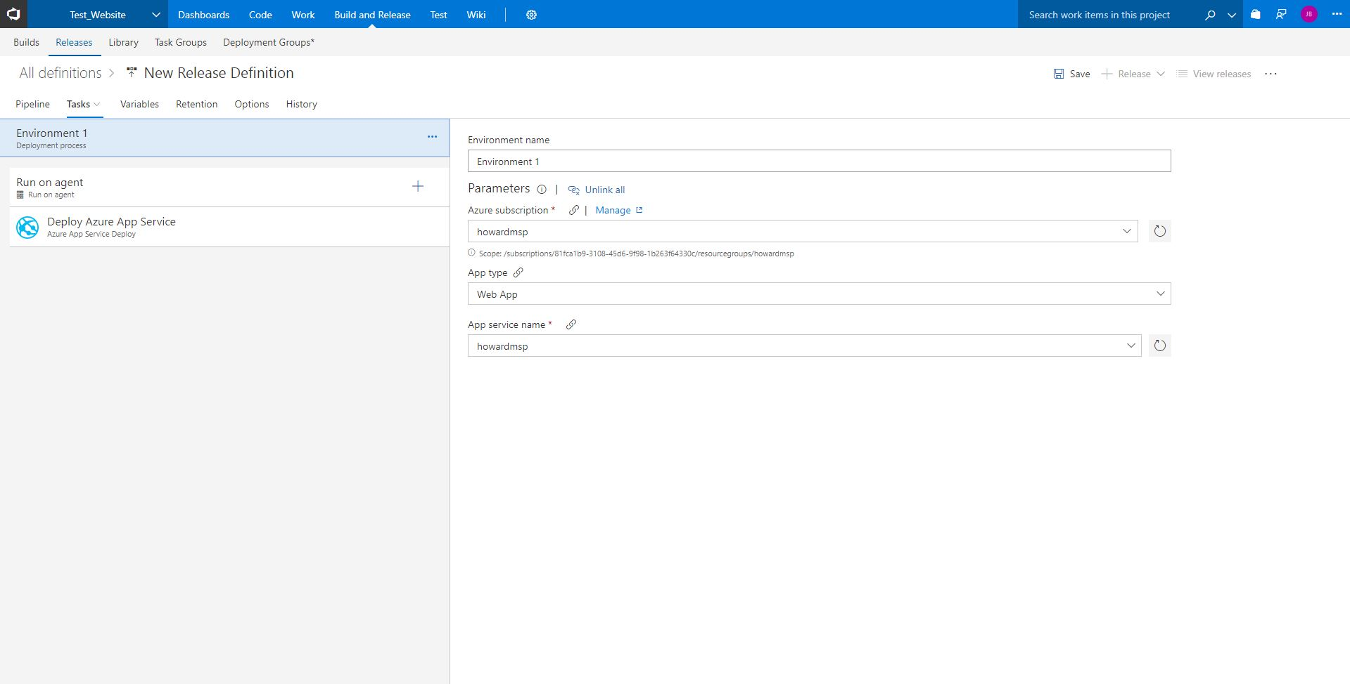
Go back to the release page
Click Pipeline

Slide 46
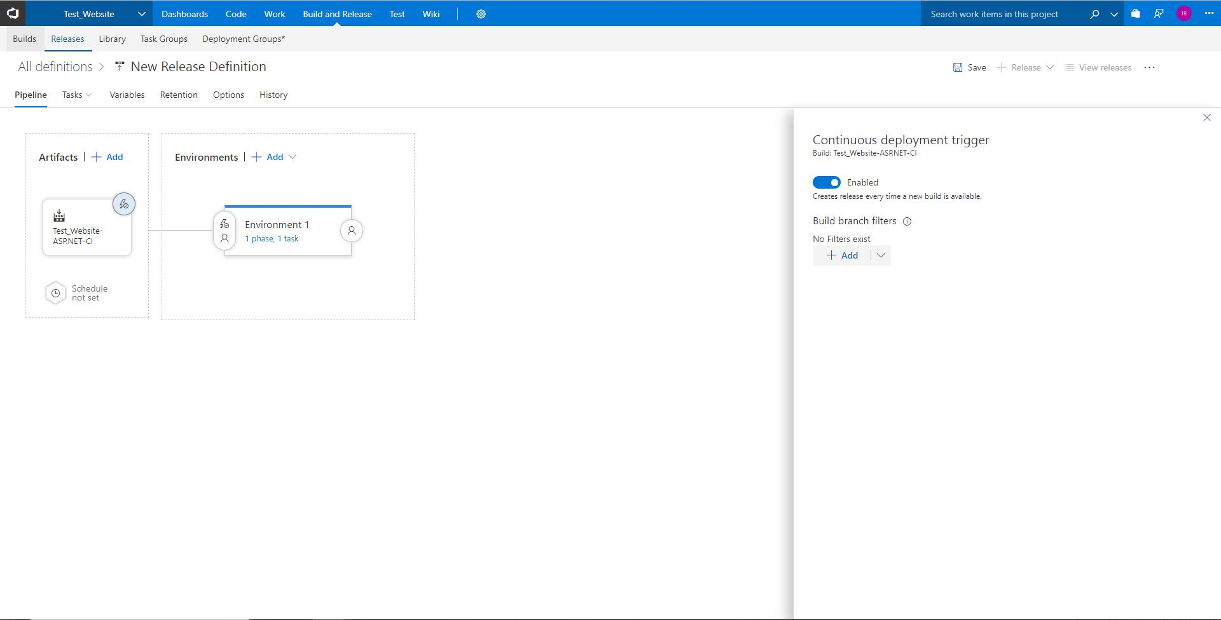
Click on this icon and enable Continuous deployment trigger
Then Click Save

Slide 47
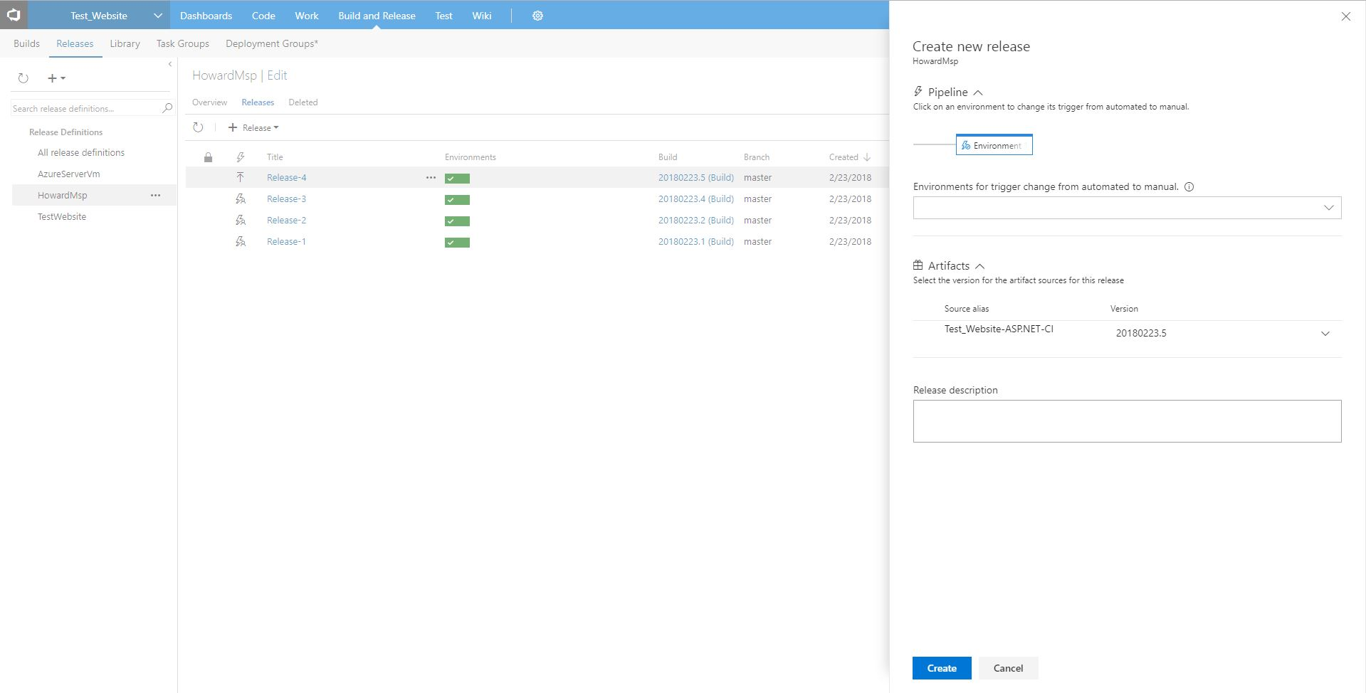
Click Create new release
Click Create
You should then see your release running
Click on the Release

Slide 48
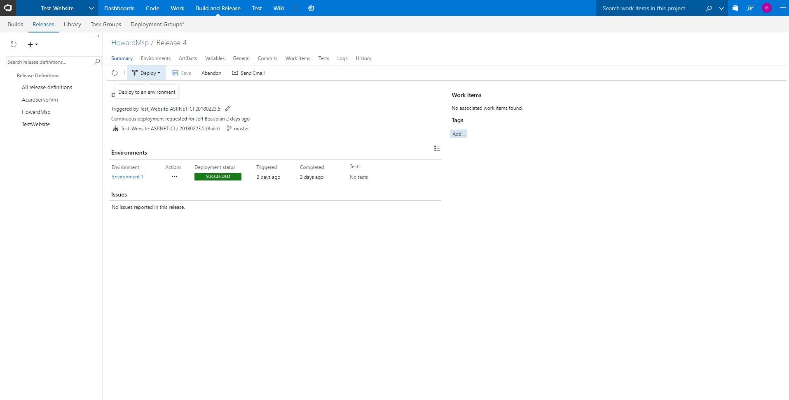
When you click on your release it should open this page.
At this point your environment isn’t deployed yet so click deploy
Once Deployment has Succeeded your website should be live! But where?

Slide 49
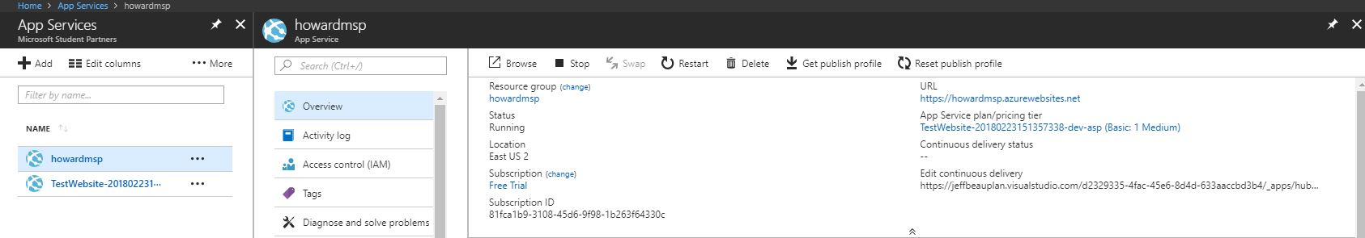
Under App Services in Azure select your app service and click overview
The URL is the link to your website

Slide 50
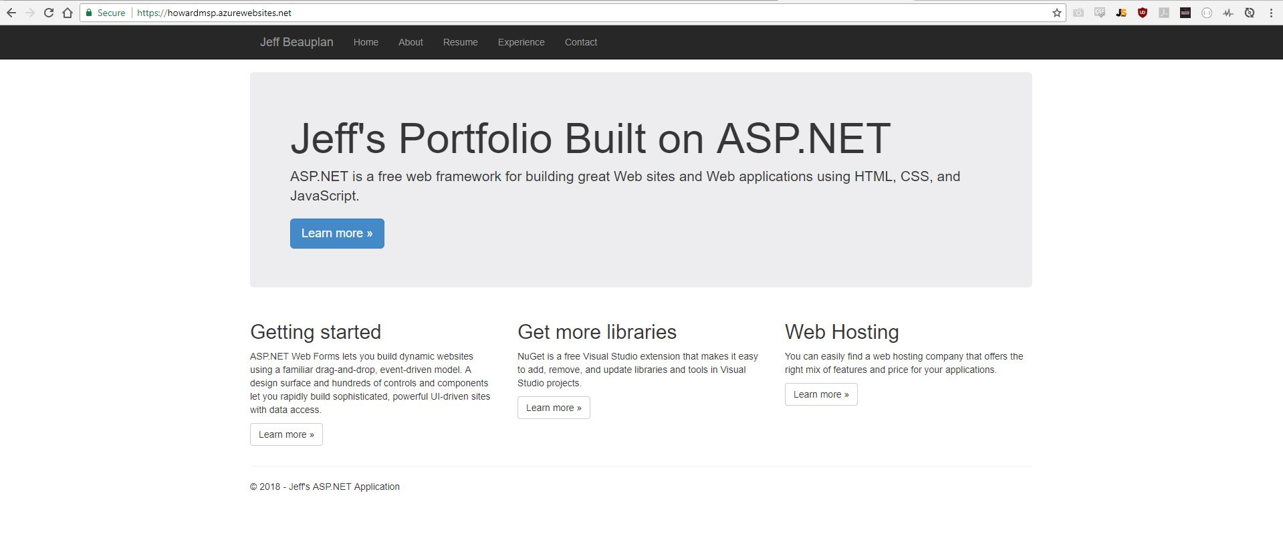
Done! Website is live! Congrats you’ve now built and deployed a website to the cloud

Slide 51
ASP.NET Workshop
By Howard University Microsoft Student Partners
Jeff Beauplan
Michelle Brown
Thank you for your time!

Slide 52

Join us on Facebook!
Click here to join our Facebook group

